Slide 1
Final Project Learning the Morphology of Brain Signals Using Alpha-Stable Convolutional Sparse Coding
Reut farkash 302629118, Ori Nizan 200955474

Slide 2
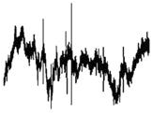
Introduction
New way of anylisis of neural time series data.
Neural time series are characteristise by many artifacts and impulsive noise
alpha stable distributions
Main goal is CSC model that is more robust to artifacts commonly seen in neural signals
Notes:
alpha stable distributions - heavy-tailed distributions

Slide 3
Brain signals types

Slide 4
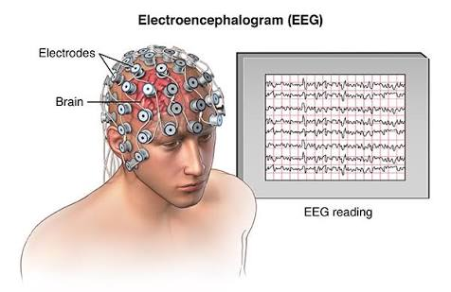
EEG
EEG or Electroencephalography
non invasive
used to diagnose epilepsy, sleep disorders, brain death and other medical conditions
sampling rates between 250 and 2000 Hz
low spatial resolution

Slide 5
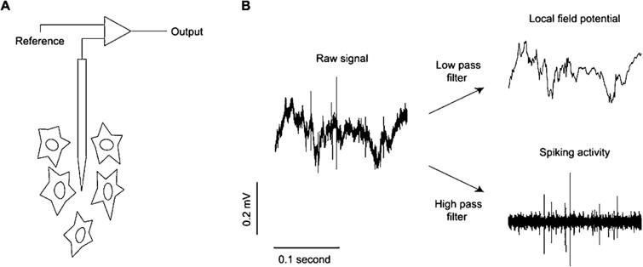
LFP
LFP - local field potential .
generated by electric current flowing from multiple nearby neurons within a small volume of nervous tissue.
voltage is recorded with a microelectrode embedded within neuronal tissue.

Slide 6
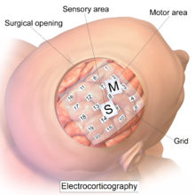
ECoG
Electrocorticography
electrodes placed directly on the exposed surface
record electrical activity from the cerebral cortex

Slide 7
Older algorithms

Slide 8
Motif
MoTIF - Matching of time invariant filters.
Learning generating functions.
Finding uncorrelated elements and fitting them to the given signal by way of generalized eigenvector decomposition.
Each atom is found by iterating between two steps:
first (after initialization) compute its best translation that fit the data.
fixing the translation and finding the best shape of the atom to fit that translation.
next atom is constrain to be uncorrelated to the previous ones.
Weaknes: does not handle correlated atoms (which are common in practice)

Slide 9
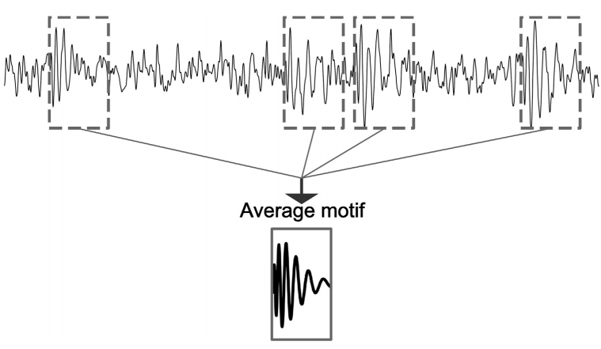
SWM
SWM -sliding window matching
works by sliding windows across the input signal in a monte carlo way.
There are basically two parts:
try to make the content in the windows to be as similar as possible to each other
averaging their content
Weakens: very slow convergence speed

Slide 10
wavelet And fourier
efficient to compute. But they fail to capture the morphology of the signals.
Known failure can be seen in the disambiguation between alpha rhythm and mu rhythm. They are both have a 10 Hz component but with different morphologies that is not visible by the Fourier or wavelet transforms.

Slide 11
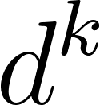
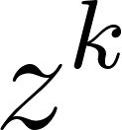
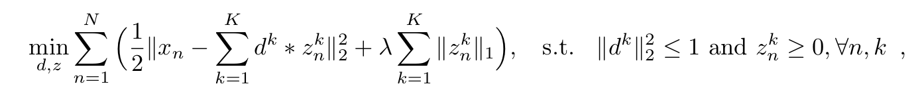
Convolutional Sparse Coding
The basic CSC problem formulation:

Slide 12
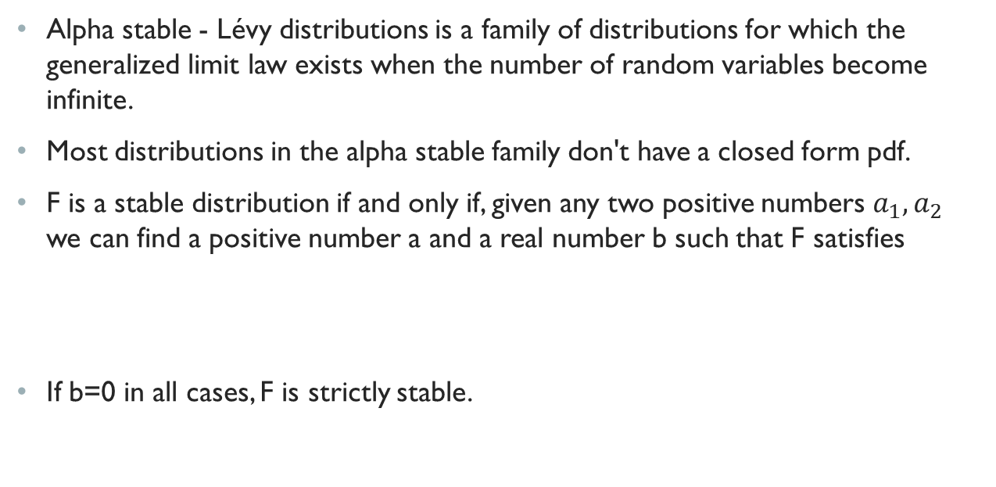

Alpha stable distributions

Slide 13
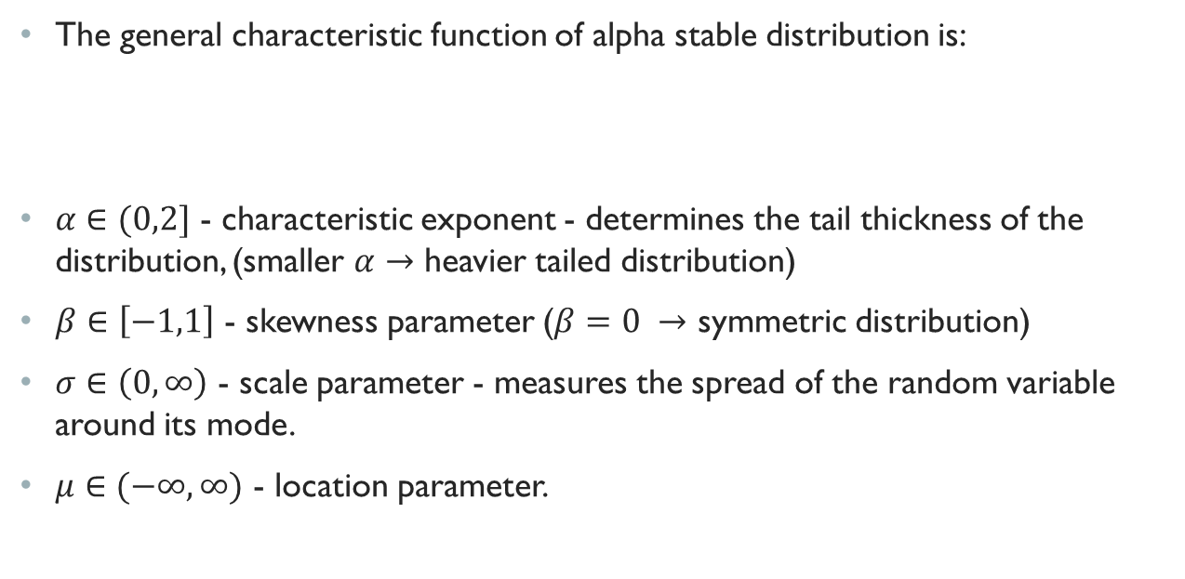
Alpha stable distributions

Slide 14

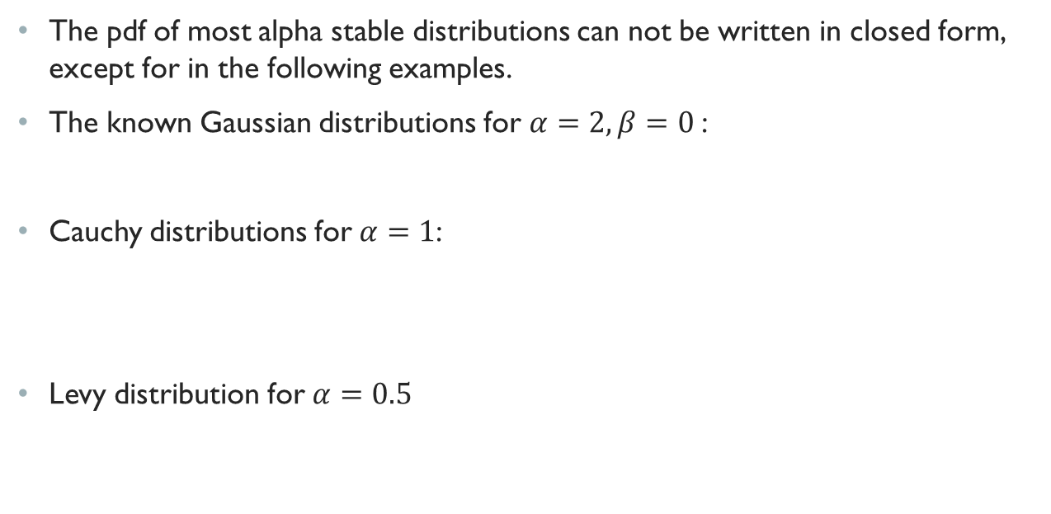
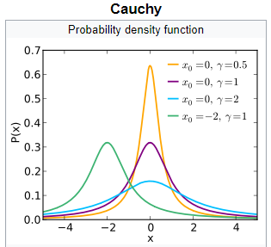
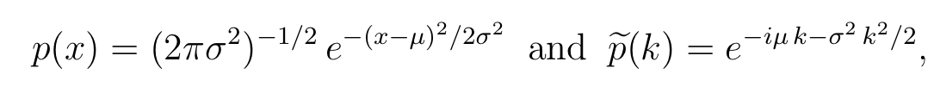
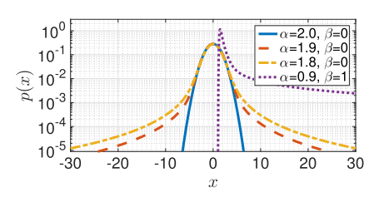
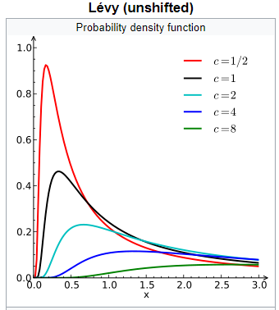
Examples of Alpha stable distributions
Notes:
Some properties: The moments of alpha stable distributions can only be defined up to the order . the distribution is heavy tailed (making Gaussians the only distributions in the alpha stable family to not be heavy tailed and to have a finite variance). the first moment does not exist

Slide 15
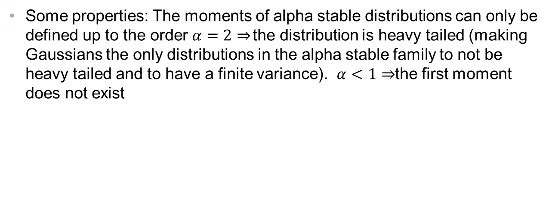
Examples of Alpha stable distributions

Slide 16
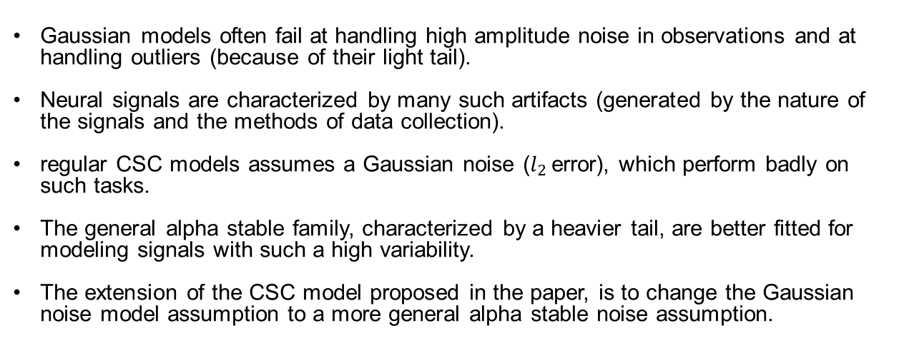
The connection of alpha stable distributions to neural signals

Slide 17
Expectation maximization
Expectation–maximization - EM algorithm is an iterative method to find maximum likelihood or maximum a posteriori - MAP estimates of parameters in statistical models.
The algorithm alternates between performing an expectation - E step, which creates a function for the expectation of the log-likelihood evaluated using the current estimate for the parameters.
And a maximization - M step, which computes parameters maximizing the expected log-likelihood found on the E step.

Slide 18
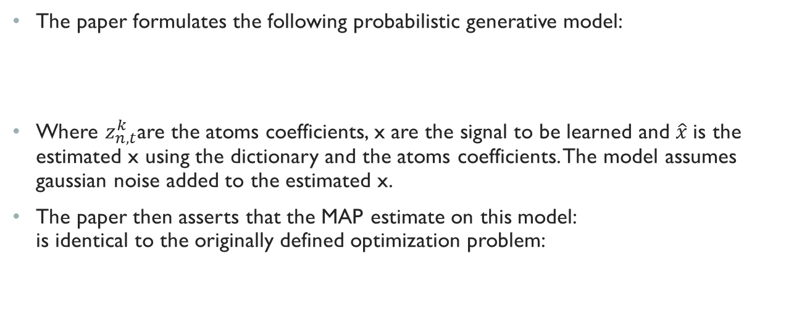
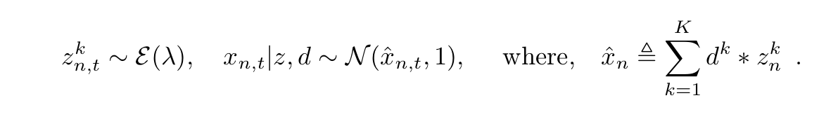

Alpha CSC presentation

Slide 19
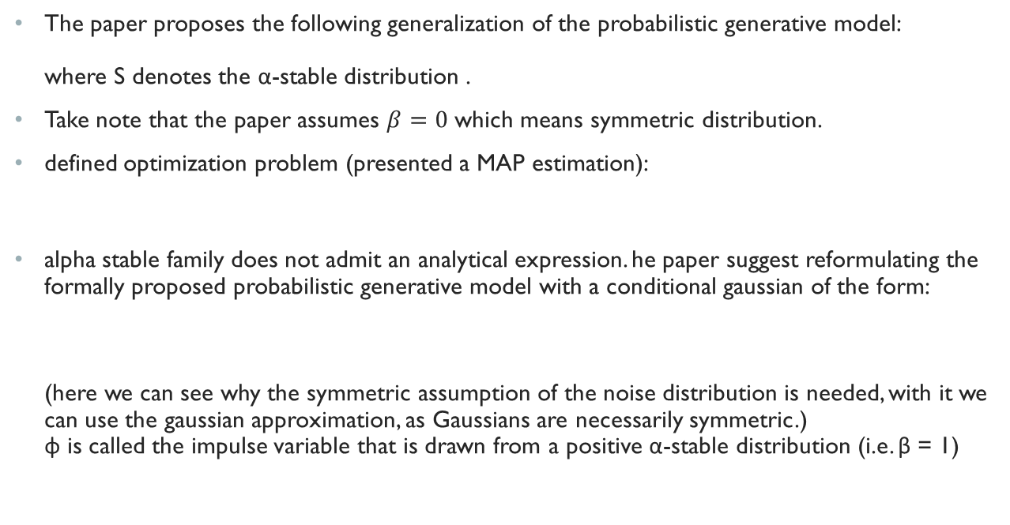

Alpha CSC presentation

Slide 20
The algorithm - Expectation maximization
The E step of the algorithm will be defined as follows:
B(i) represent a lower bound on log p(d, z|x) and this is a tight bound at the current iterates z(i), d(i).

Slide 21



The E-Step
The B for our problem take the following form : the weights that are defined as follows: represents the variance of the gaussian noise in our model, so we can interpret these weights as being small when the variance of x is big and vise versa. This is what makes this approach more robust than the regular one.

Slide 22
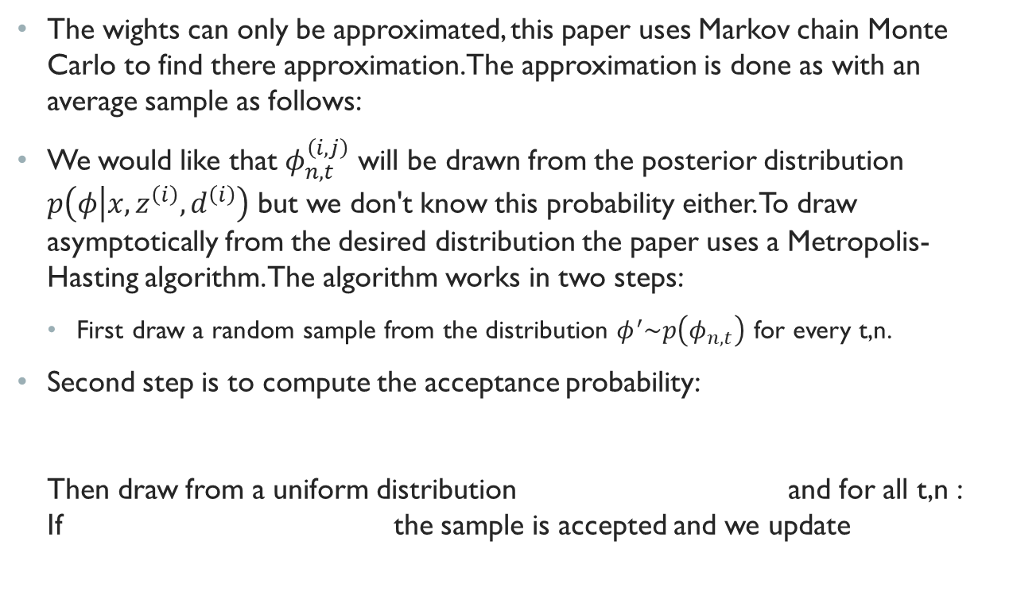




The E-Step

Slide 23


M-step
The M-steps basically solves a weighted CSC with the wightes found in the previous stage. This problem is solve by iterating between fixing z and solve for d and vise versa. Fixing d gives the following expression: The paper solves this problem using L-BFGS-B algorithm.
For d the expression to be minimize is: Which can be solved using FISTA, or solve the dual problem using L-BFGS-B which the paper claim is the more efficient way.

Slide 24
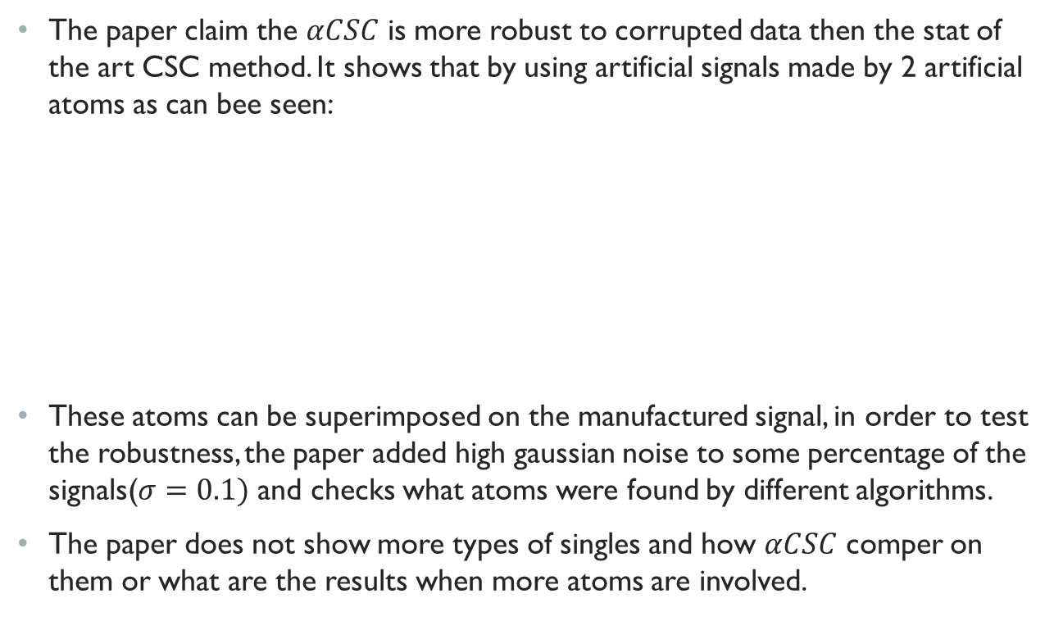
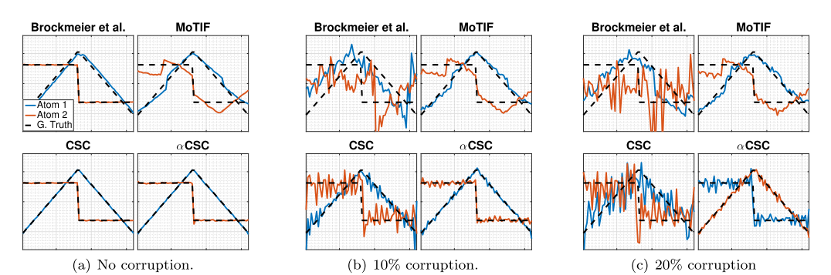
Results

Slide 25
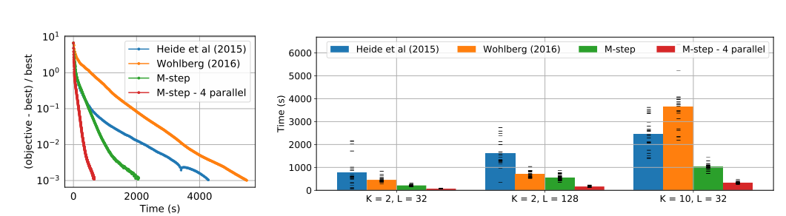
Results
The paper also show that it M - step is more efficient and converge faster than the standard approaches on specific manufactured setup:

Slide 26
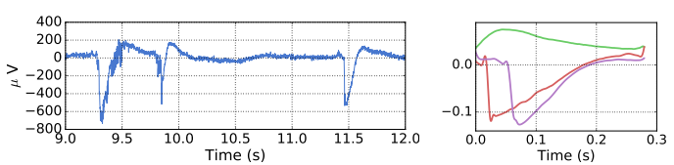
Results
On real data the paper shows the algorithm achieves atoms reported in other works but without using any heuristic approach: (compere to the results achieved in Adaptive Waveform Learning: A Framework for Modeling Variability in Neurophysiological Signals)

Slide 27
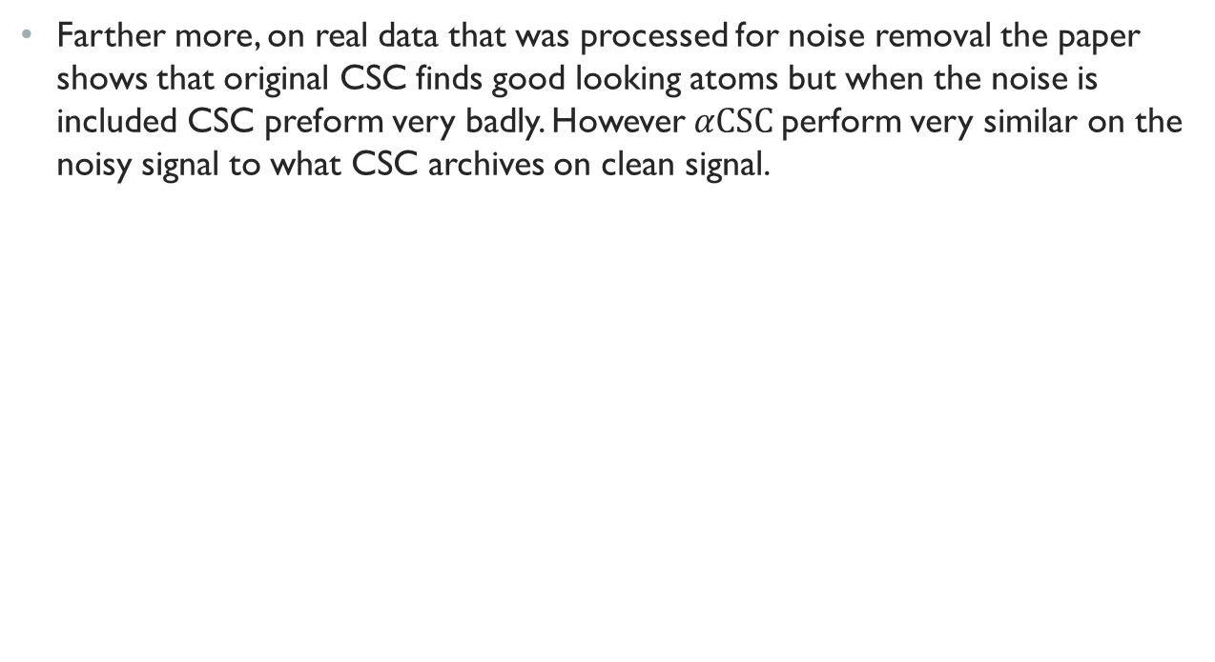
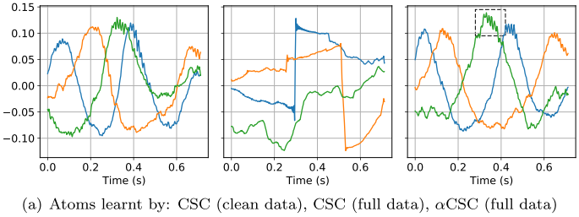
Results

Slide 28
Critic
As stated previously, the paper assumes symmetric signals in its search of the alpha stable family. Perhaps more could be gain by neglecting this assumption although the optimization problem could be more difficult to solve.
Another point that should be noted is the lack of a quantitative analysis of the paper’s results that would allow for a comparison with other papers in the field. The paper only gives a visual example of the results of different methods, but there is no metric by which to judge them.
The paper doesn't talk about the method drawbacks and weakness.

Slide 29
Conclusion
We saw in this paper a relative new way of performing CSC coding, taking different assumption of the noise from the regular approaches that are better suited for gaussian type noises.
The noise assumption this paper assumes is of an alpha stable distribution which is heavy tailed family of distribution and is more characteristic of noise seen in neural signals.
The paper talked about their main idea behind the noise assumption and there way of using it to create a new CSC optimization algorithm.
Finally the paper shows improvement on some signals types common in brain research studies.
Notes:
Anti atoms

